Slide 1



GEORILLA
AI - Powered Geo - Location Based Attendance System
Presented by
Hackshastra

Slide 2

Introduction
we aim to develop an application that simplifies and automates employee attendance tracking across multiple office locations. The app will use geolocation technology to accurately capture check-in and check-out times, along with the employee's location, as they enter or exit office premises.

Slide 3

PROPOSED SOLUTION
We propose a robust and secure mobile/web-based attendance system that utilizes geolocation to automate and validate employee check-ins and check-outs across multiple office locations.
1 ) Core Functionalities :
Real-time Location Tracking: Capture user coordinates using the HTML5 Geolocation API.
Geo-fencing Enforcement:
Apply the Haversine formula to ensure users are physically within a defined office radius before allowing attendance actions.
Conditional Attendance Marking:
Check-in and check-out options are displayed only when the user is inside the geofence and hasn’t already marked attendance.
2)Critical Enhancements :
Identity Verification: Implement face recognition during check-in to prevent proxy attendance, using facial embeddings
compared with stored profiles.
Anomaly Detection:
Monitor location and time patterns using machine learning to flag suspicious or inconsistent
attendance behavior.
Attendance Insights and Forecasting:
Apply time series analysis to forecast absenteeism and provide
trend reports for administrative planning.

Slide 4

TECH-STACK
Frontend: React.js with responsive UI libraries.
Backend: Node.js with Express for scalable API handling.
Database: MongoDB or PostgreSQL for structured attendance records.
Authentication: JWT-based token system with role-based access control.
AI Integrations: Face recognition, anomaly detection, and predictive analytics using libraries like face-api.js, scikit-learn, and TensorFlow.js.
Geo-Location: HTML5 Geolocation API, Google Maps API.

Slide 5

Feasibility and Viability
The proposed geo-location-based attendance system is both feasible and viable, utilizing only open-source and free technologies. Technically, it can be built using well-established web development tools such as HTML5 Geolocation API for accurate location tracking, Node.js with Express for backend services, and a database like MongoDB or PostgreSQL for secure data storage. The system supports core functionalities such as automatic check-in/check-out within a defined radius, manual location-based entries for offsite work, and accurate calculation of total working hours. It also ensures tamper-proof logging, real-time data synchronization, and secure communication through HTTPS and JWT authentication. Operationally, the solution improves accuracy, eliminates manual tracking errors, and provides flexibility for different work environments. Economically, the solution is highly cost-effective, requiring no licensing or proprietary resources, making it ideal for scalable, real-world deployme

Slide 6

FEATURES
Real-Time Geo-Location Based Check-In/Check-Out
Automatically records employee attendance when they enter or exit a 200-meter radius of the office, ensuring accurate and hands-free tracking.
Manual Attendance with Location Suggestions for Offsite Work
Enables employees working outside office locations to check in manually, with intelligent suggestions based on current GPS coordinates for validation.
Tamper-Proof and Real-Time Data Synchronization
Ensures all attendance records are securely logged, synchronized instantly across the system, and protected from unauthorized changes using secure APIs and best database practices.
AI-Based Spoofing and Location Authenticity Detection
Uses AI models to detect location spoofing or unusual patterns, ensuring only genuine physical presence is accepted for check-ins.
Secure Role-Based User Authentication and Admin Dashboard
Provides encrypted access and differentiated user roles, along with a powerful admin dashboard featuring map-based check-in views and auto-generated attendance reports (daily, weekly, monthly).

Slide 7

Impact and Benefits
The proposed attendance system offers high impact by enhancing operational efficiency and ensuring secure, real-time tracking of employee presence. It eliminates manual errors through automated geo-location-based check-in and check-out within a defined office radius. AI-based spoofing detection prevents misuse and ensures only authentic data is recorded. Manual check-in for offsite work, with smart location suggestions, supports hybrid and field-based roles. All records are tamper-proof and synchronized in real time using secure APIs and database practices. The system provides secure role-based access for users and admins, while offering comprehensive attendance reports, map views, and trend analytics to support better decision-making, compliance, and transparency across the organization.

Slide 8
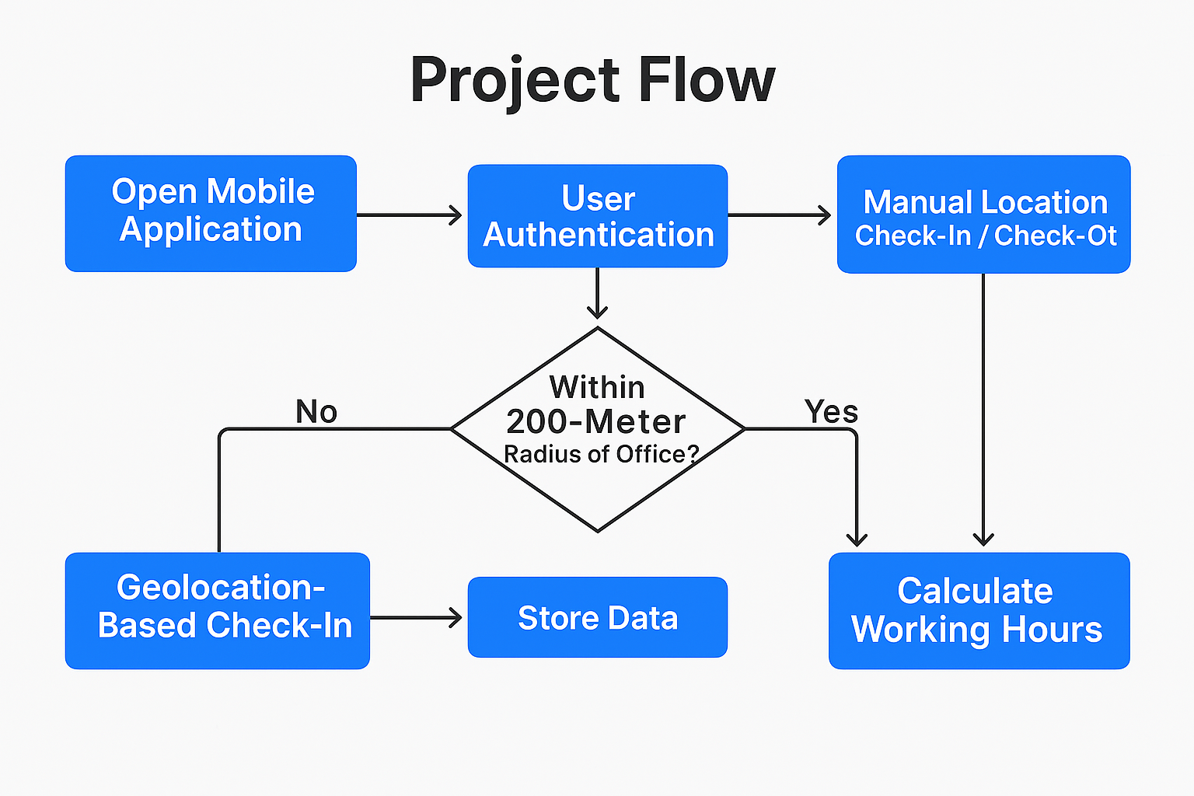
PROJECT FLOW

Slide 9
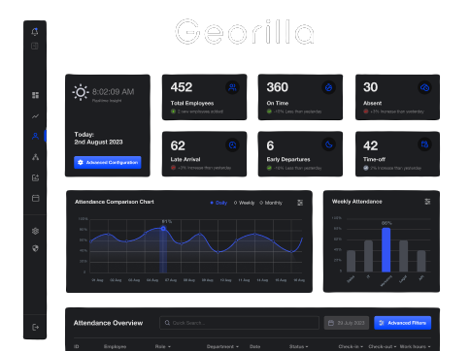
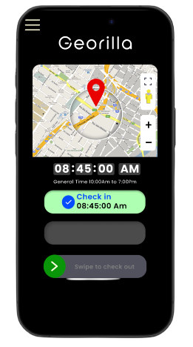
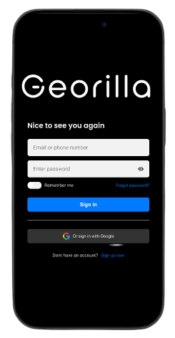
PROTOTYPE DESIGN

Slide 10



Thank You

